Slide 1

ALGORITHM DESIGN & IMPLEMENTATION
Phase 2 — Algo
Algorithm Design & Implementation (Shortest Path on Maps) Pathfinding Algorithm Comparison (Dijkstra vs A*)

Slide 2


Table of Contents
1. Phase 2 Overview & Deliverables
5. A*: Pseudocode, Heuristic & Key Steps
2. Map Graph Data Structure Design
6. A*: Java Implementation Highlights
3. Dijkstra: Pseudocode & Key Steps
7. User Input & Output Display
4. Dijkstra: Java Implementation Highlights
8. Test Cases & Wrap-up

Slide 3




Phase 2 Objectives and Deliverables
Implement and compare Dijkstra vs A* for shortest path on a map graph
Objectives
Deliverables
Design and implement both algorithms
Working shortest-path finder for user-selected start/destination
Write clear pseudocode for Dijkstra and A*
Outputs shown: shortest path, total distance, execution time, visited nodes count
Implement using Java

Slide 4

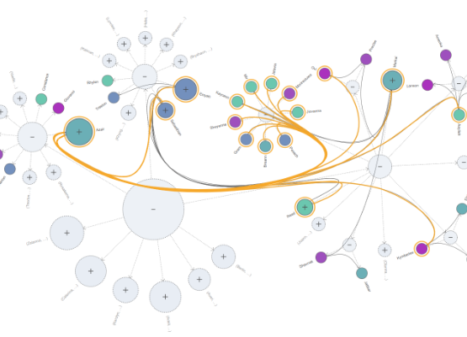
Graph Representation for the Map
Core Map Elements
Nodes: map points / intersections
Edges: road connections
Weights: travel distances
Implementation Strategy
Representation choice: Adjacency list (optimized for algorithm efficiency).
Inputs consumed: Starting point node and Destination node.

Slide 5
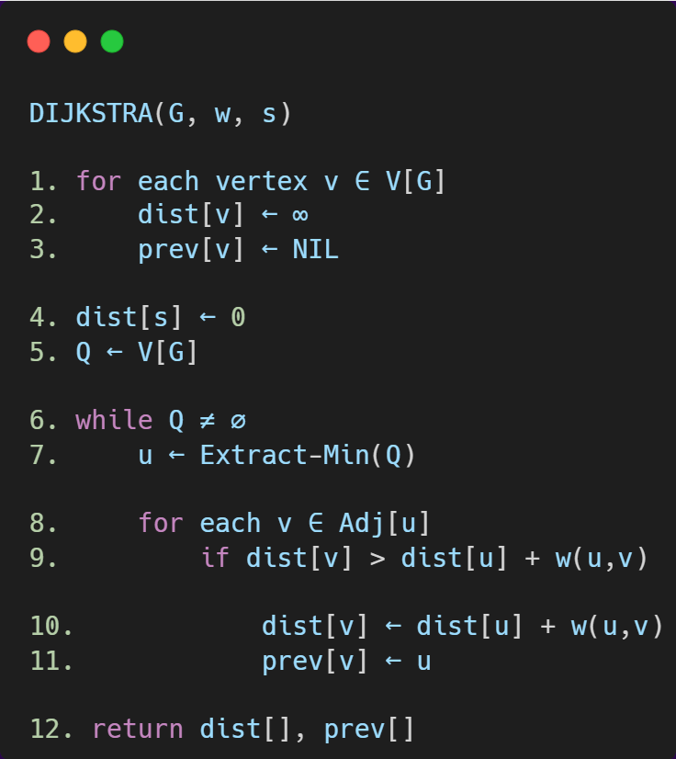
Dijkstra — Pseudocode
Algorithm Logic
Constraint: Requires non-negative edge weights.
Output Produced:
Shortest / optimal path
Total computed distance
Designed for finding the shortest path from a single source to all nodes or a specific goal.

Slide 6
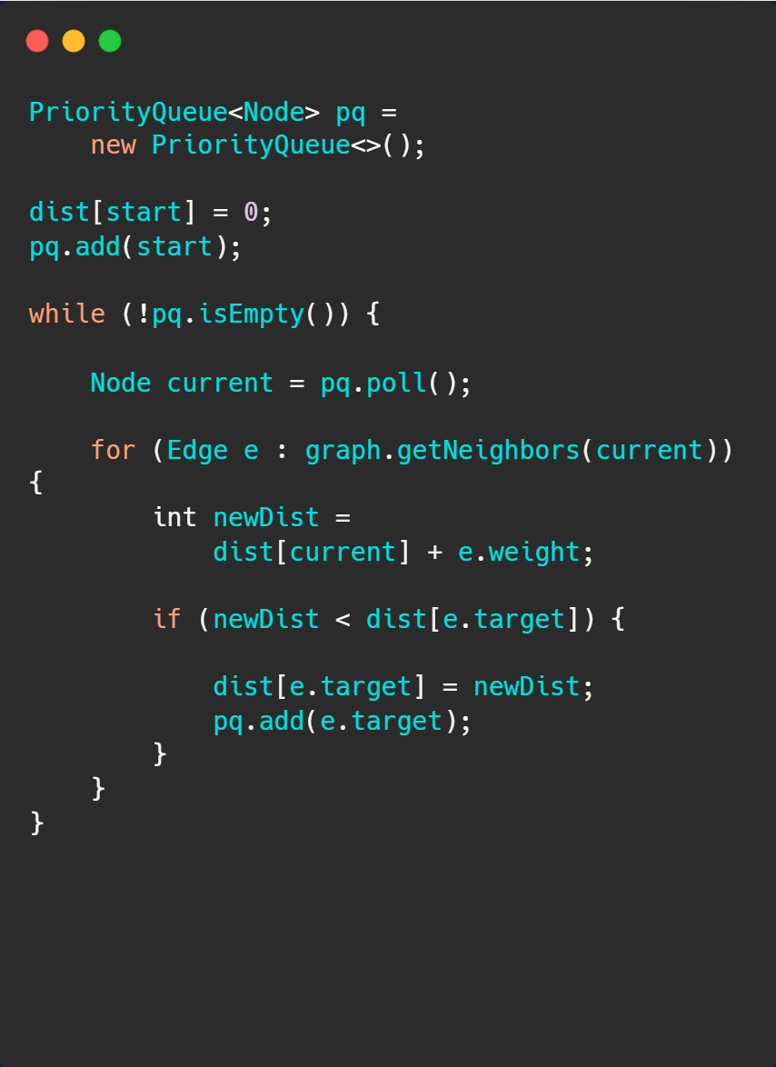
Dijkstra — Java Implementation Highlights
Technical Key Points
Uses Priority Queue to always process the next nearest node.
Dynamically updates shortest distances (Relaxation step).
Guaranteed to find the optimal shortest path.

Slide 7
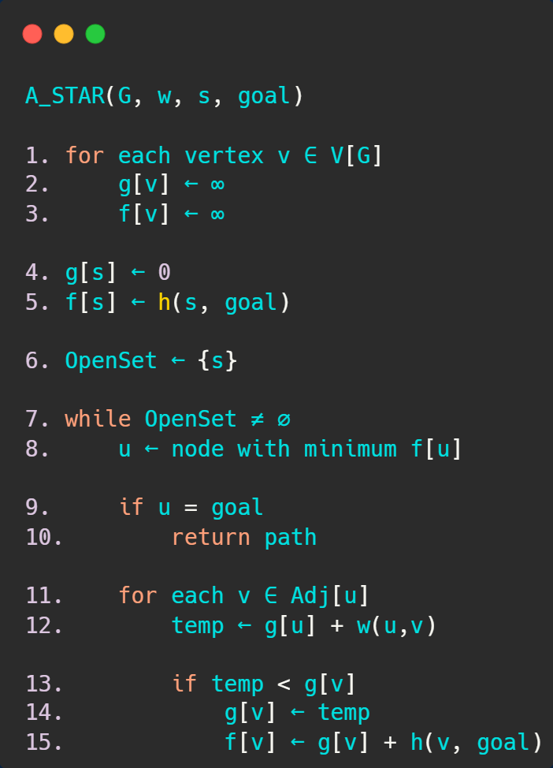

A* — Pseudocode (Heuristic-Guided)
Search Heuristics
f(n) = g(n) + h(n)
g(n): actual cost | h(n): estimated cost
Heuristic Role: Guides search toward destination while preserving optimality.
Constraint: Requires an admissible heuristic.

Slide 8
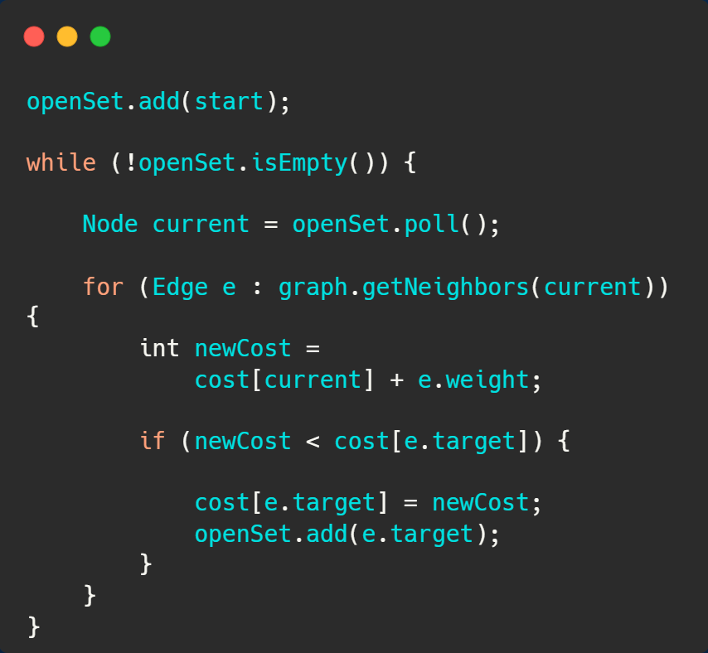
A* — Java Implementation Highlights
Efficiency Comparison
Uses heuristic function to focus the search toward the goal.
Significantly faster than Dijkstra in many navigation cases.
Finds the optimal path efficiently with fewer node visits.

Slide 9






User Input Handling and Result Display
User Inputs
System Behavior
Display Outputs
System requests Starting point and Destination from the user.
Runs Dijkstra and A* on the same graph to collect comparative metrics.
Shows Shortest path, Total distance, Execution time, and Visited nodes count.

Slide 10
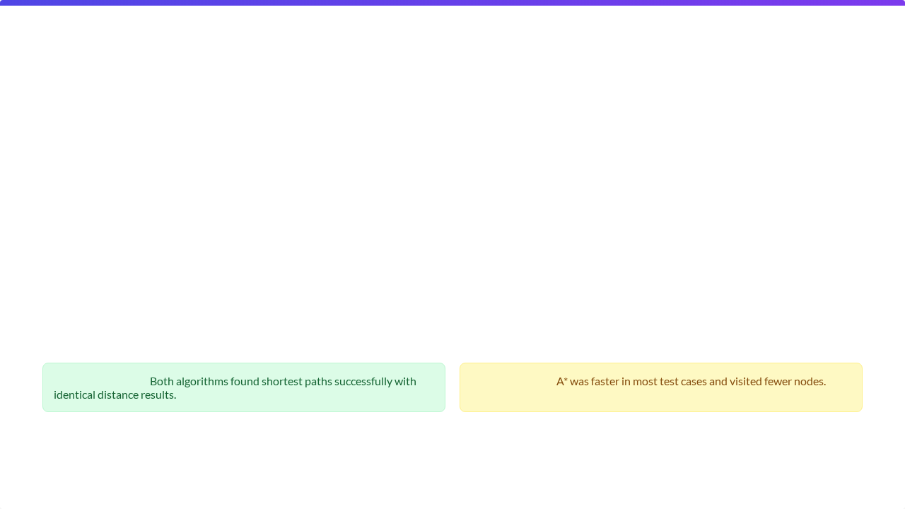
Test Cases & Validation
Start Node | Destination | Dijkstra Shortest Path | A* Shortest Path | Total Distance
A | E | A → C → E | A → C → E | 8
C | D | B → D | B → D | 3
B | A | C → B → A | C → B → A | 7
Validation Results:
Efficiency Note:

Slide 11


Test Cases and Key Implementation Points
Verification Metrics
Monitoring execution time per test.
Phase 2 Delivery: Java implementations + pseudocode + user I/O + correctness tests for Dijkstra vs A*.
Tracking the number of visited nodes.
Ensuring efficiency in finding shortest path.
Consistency verified across different start/destination selections.

